Slide 1
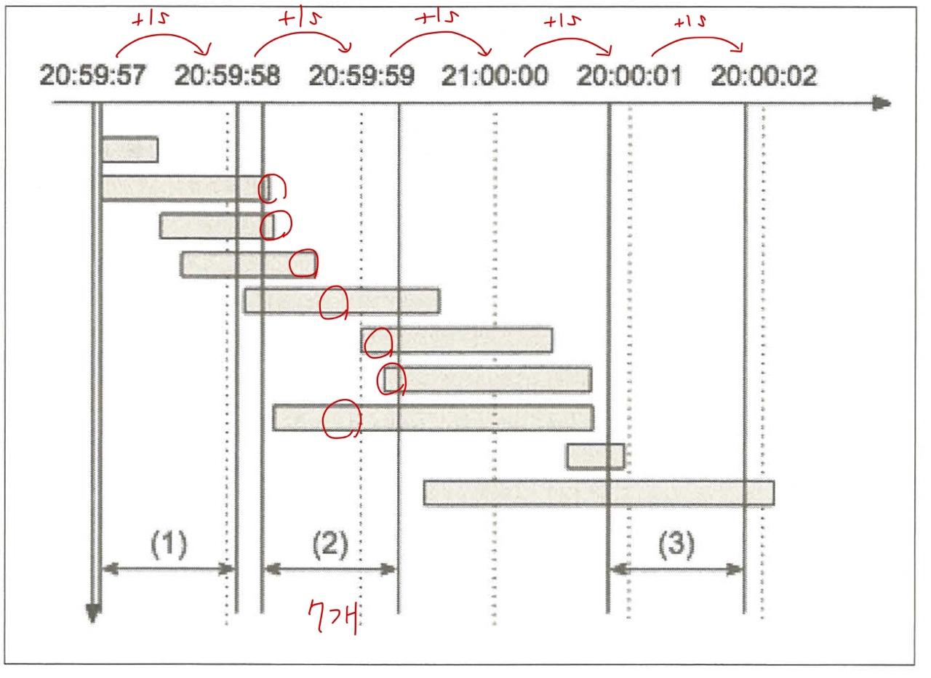
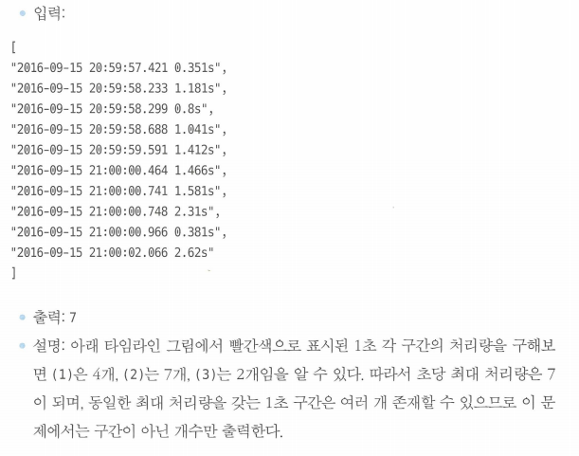
B7) 추석 트래픽

Slide 2
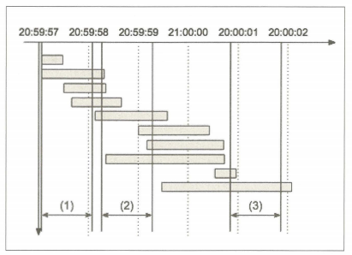
B7) 추석 트래픽

Slide 3
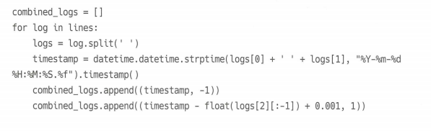
B7) 추석 트래픽
"2016-09-15 20:59:57.421 0.351s", "2016-09-15 20:59:58.233 1.181s", "2016-09-15 20:59:58.299 0.8s", "2016-09-15 20:59:58.688 1.041s", "2016-09-15 20:59:59.591 1.412s", "2016-09-15 21:00:00.464 1.466s", "2016-09-15 21:00:00.741 1.581s", "2016-09-15 21:00:00.748 2.31s", "2016-09-15 21:00:00.966 0.381s", "2016-09-15 21:00:02.066 2.62s" | ['2016-09-15', '20:59:57.421', '0.351s'] ['2016-09-15', '20:59:58.233', '1.181s'] ['2016-09-15', '20:59:58.299', '0.8s'] ['2016-09-15', '20:59:58.688', '1.041s'] ['2016-09-15', '20:59:59.591', '1.412s'] ['2016-09-15', '21:00:00.464', '1.466s'] ['2016-09-15', '21:00:00.741', '1.581s'] ['2016-09-15', '21:00:00.748', '2.31s'] ['2016-09-15', '21:00:00.966', '0.381s'] ['2016-09-15', '21:00:02.066', '2.62s']

Slide 4
B7) 추석 트래픽
['2016-09-15', '20:59:57.421', '0.351s'] ['2016-09-15', '20:59:58.233', '1.181s'] ['2016-09-15', '20:59:58.299', '0.8s'] ['2016-09-15', '20:59:58.688', '1.041s'] ['2016-09-15', '20:59:59.591', '1.412s'] ['2016-09-15', '21:00:00.464', '1.466s'] ['2016-09-15', '21:00:00.741', '1.581s'] ['2016-09-15', '21:00:00.748', '2.31s'] ['2016-09-15', '21:00:00.966', '0.381s'] ['2016-09-15', '21:00:02.066', '2.62s'] | 1473940797.421 1473940798.233 1473940798.299 1473940798.688 1473940799.591 1473940800.464 1473940800.741 1473940800.748 1473940800.966 1473940802.066

Slide 5
B7) 추석 트래픽
[(1473940797.421, -1), (1473940797.0709999, 1), (1473940798.233, -1), (1473940797.053, 1), (1473940798.299, -1), (1473940797.5, 1), (1473940798.688, -1), (1473940797.648, 1), (1473940799.591, -1), (1473940798.18, 1), (1473940800.464, -1), (1473940798.9989998, 1), (1473940800.741, -1), (1473940799.1609998, 1), (1473940800.748, -1), (1473940798.439, 1), (1473940800.966, -1), (1473940800.586, 1), (1473940802.066, -1), (1473940799.447, 1)]

Slide 6
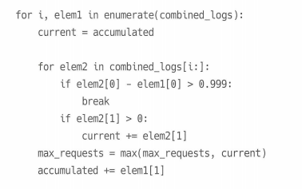
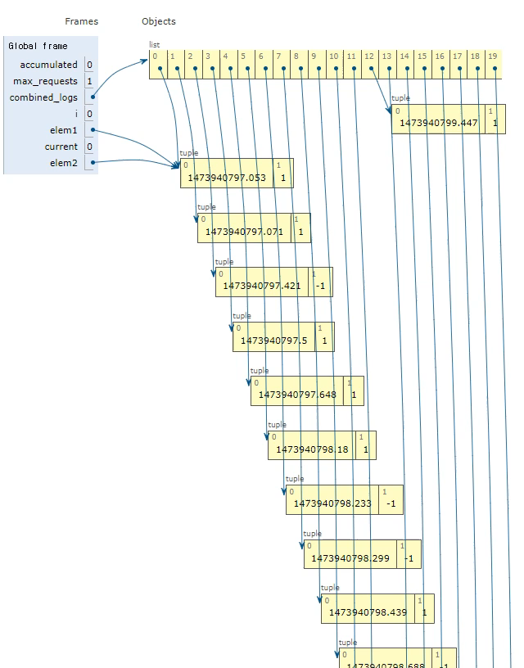

B7) 추석 트래픽
[(1473940797.421, -1), (1473940797.0709999, 1), (1473940798.233, -1), (1473940797.053, 1), (1473940798.299, -1), (1473940797.5, 1), (1473940798.688, -1), (1473940797.648, 1), (1473940799.591, -1), (1473940798.18, 1), (1473940800.464, -1), (1473940798.9989998, 1), (1473940800.741, -1), (1473940799.1609998, 1), (1473940800.748, -1), (1473940798.439, 1), (1473940800.966, -1), (1473940800.586, 1), (1473940802.066, -1), (1473940799.447, 1)]
Combined_logs

Slide 7
B7) 추석 트래픽
[(1473940797.421, -1), (1473940797.0709999, 1), (1473940798.233, -1), (1473940797.053, 1), (1473940798.299, -1), (1473940797.5, 1), (1473940798.688, -1), (1473940797.648, 1), (1473940799.591, -1), (1473940798.18, 1), (1473940800.464, -1), (1473940798.9989998, 1), (1473940800.741, -1), (1473940799.1609998, 1), (1473940800.748, -1), (1473940798.439, 1), (1473940800.966, -1), (1473940800.586, 1), (1473940802.066, -1), (1473940799.447, 1)]
Combined_logs

Slide 8
B7) 추석 트래픽
[(1473940797.421, -1), (1473940797.0709999, 1), (1473940798.233, -1), (1473940797.053, 1), (1473940798.299, -1), (1473940797.5, 1), (1473940798.688, -1), (1473940797.648, 1), (1473940799.591, -1), (1473940798.18, 1), (1473940800.464, -1), (1473940798.9989998, 1), (1473940800.741, -1), (1473940799.1609998, 1), (1473940800.748, -1), (1473940798.439, 1), (1473940800.966, -1), (1473940800.586, 1), (1473940802.066, -1), (1473940799.447, 1)]
Combined_logs

Slide 9
B7) 추석 트래픽

